Slide 1
Bootcamp 2020
Session 03: Introduction to K8s
Tomas Pizarro Moreno

Slide 2
Resources:
https://github.com/tompizmor/bootcamp-k8s-2020

Slide 3
Introduction
Installation and Setup
Kubectl an the K8s API
Deploying your Apps on K8s
Services
Configuring your Apps on K8s
Exercises

Slide 4
Introduction

Slide 5
Introduction
Kubernetes is an open-source software for automating deployment, scaling, and management of containerized applications.
Provides a powerful API to manage distributed applications.
Built on 15 years of experience at Google
Apache Software License
Now governed by the CNCF (Cloud Native Computing Foundation) at the Linux Foundation
Several Special Interest Groups (SIG)
Open to everyone
Weekly Hangouts

Slide 6
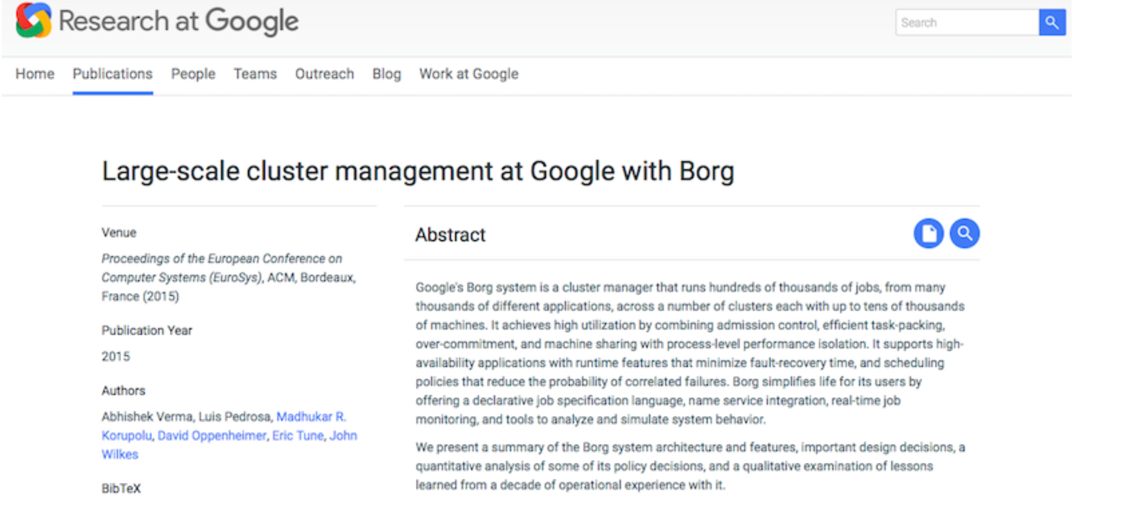
Introduction
Origin of K8s: Borg
Borg was a Google secret for a long time
Orchestration system to manage all Google applications at scale
Finally described publicly in 2015
Paper explains ideas behind Kubernetes

Slide 7
Introduction
Kubernetes Lineage
Google contributed cgroups to the Linux kernel
cgroups and linux namespaces are the heart of containers
Mesos was inspired by discussions with Google when Borg was still secret
Cloud Foundry implements 12 factor apps principles for microservices apps
Omega
OCI
Kubernetes
Cloud
Foundry
Docker
Rkt/appc
Mesos
LXC
cgroups
Borg

Slide 8



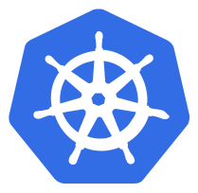



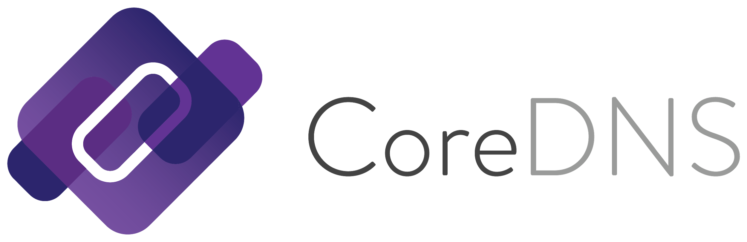

Introduction
Center of the Cloud-Native ecosystem

Slide 9









Introduction
Used in several projects
and more...

Slide 10
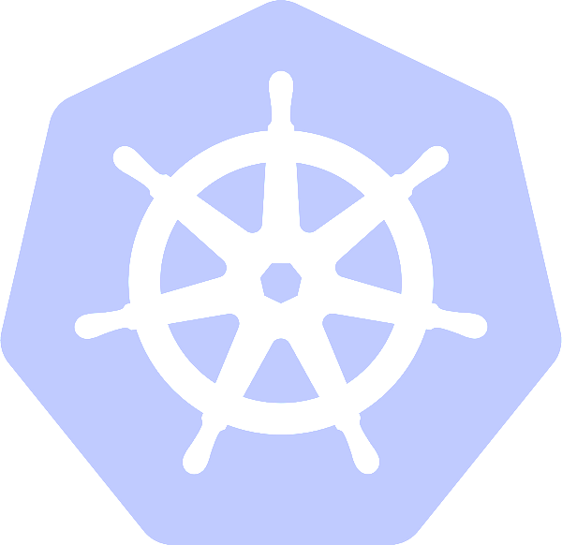
Introduction
Kubernetes Lineage
Open Source in June 2014 (6 years old)
+2K contributors
~80K commits
Second Biggest Golang project on GitHub (Docker #1)
Google & Red Hat lead contributors (check contribution by company)
+30K people on Slack (https://kubernetes.slack.com)
1 major release every 3 months (currently 1.17)

Slide 11
Introduction
What is it really?
A cluster manager
A scheduler to place containers in a cluster
Lots of HA features
Geared towards managing apps at scale
Deployed as services on VMs or Bare-metal machines
Kubectl, ajax, etc.
etcd
API Server
Scheduler
Kubelet
Service Proxy
Controller Manager
Kubernetes Architecture

Slide 12

Introduction
A tour of web resources
Some references:
kubernetes.io documentation
Bitnami Documentation
CNCF
GitHub
YouTube Channels
1
2
3
4
5

Slide 13
Installation and Setup

Slide 14
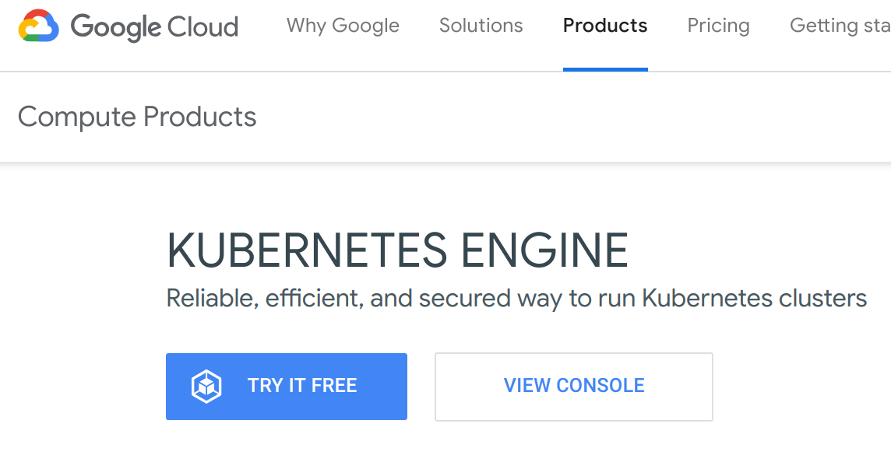
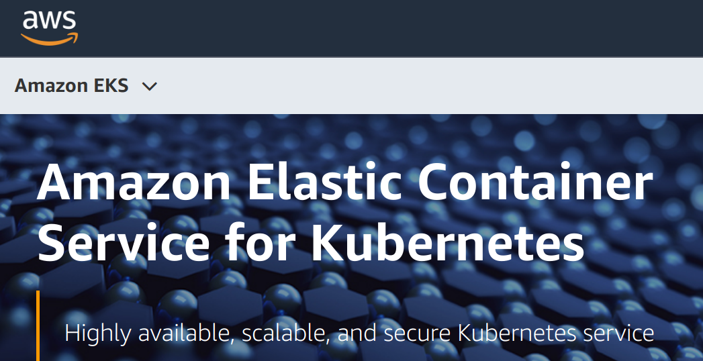
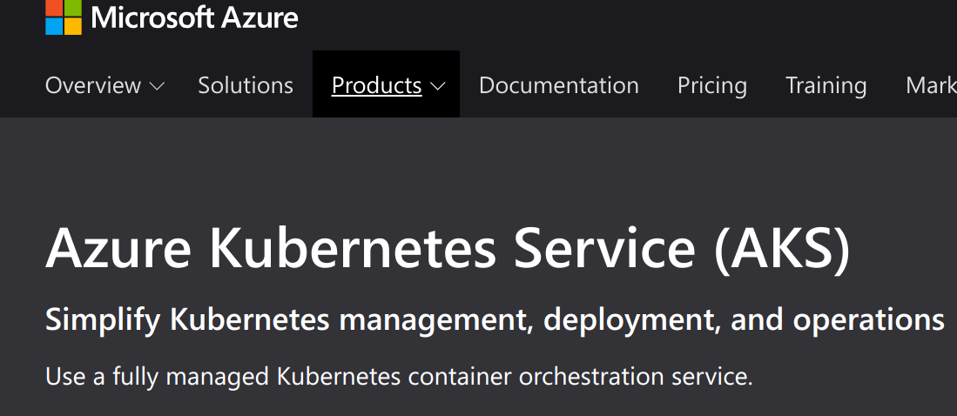
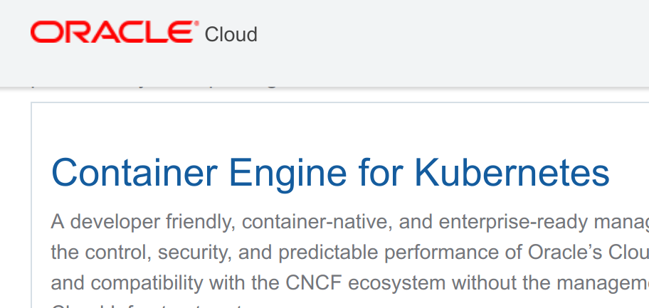
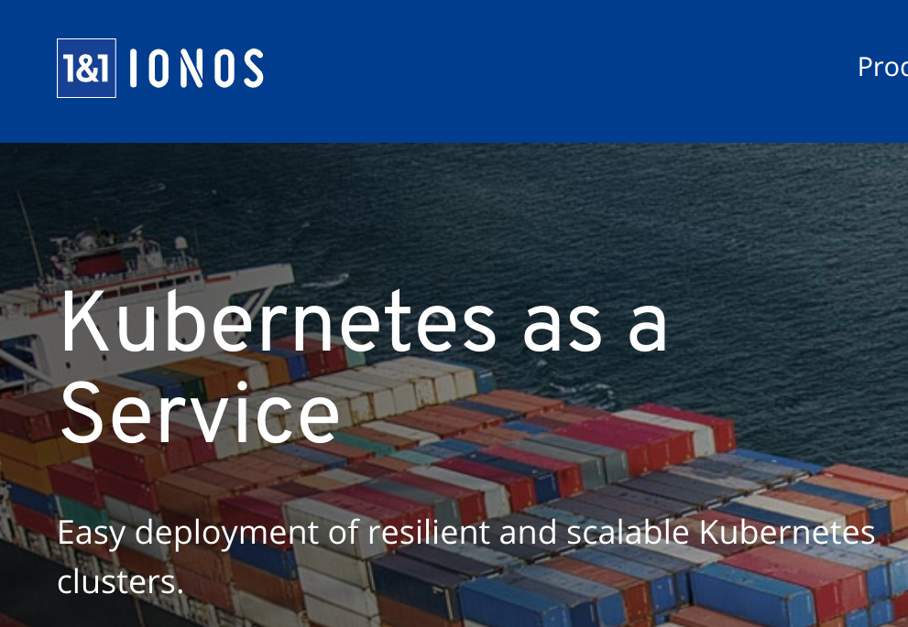
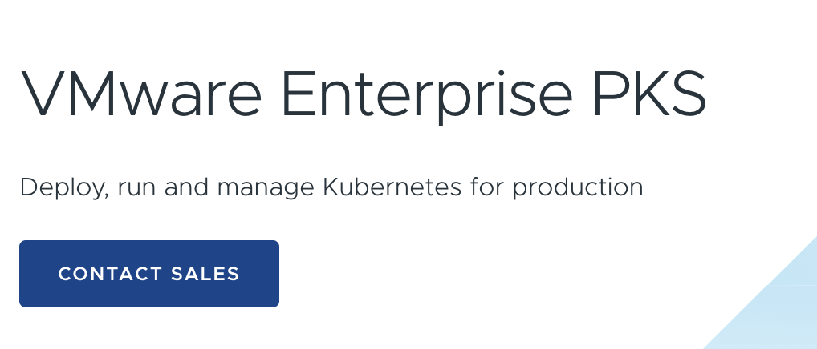
Cloud Provider Solutions

Slide 15
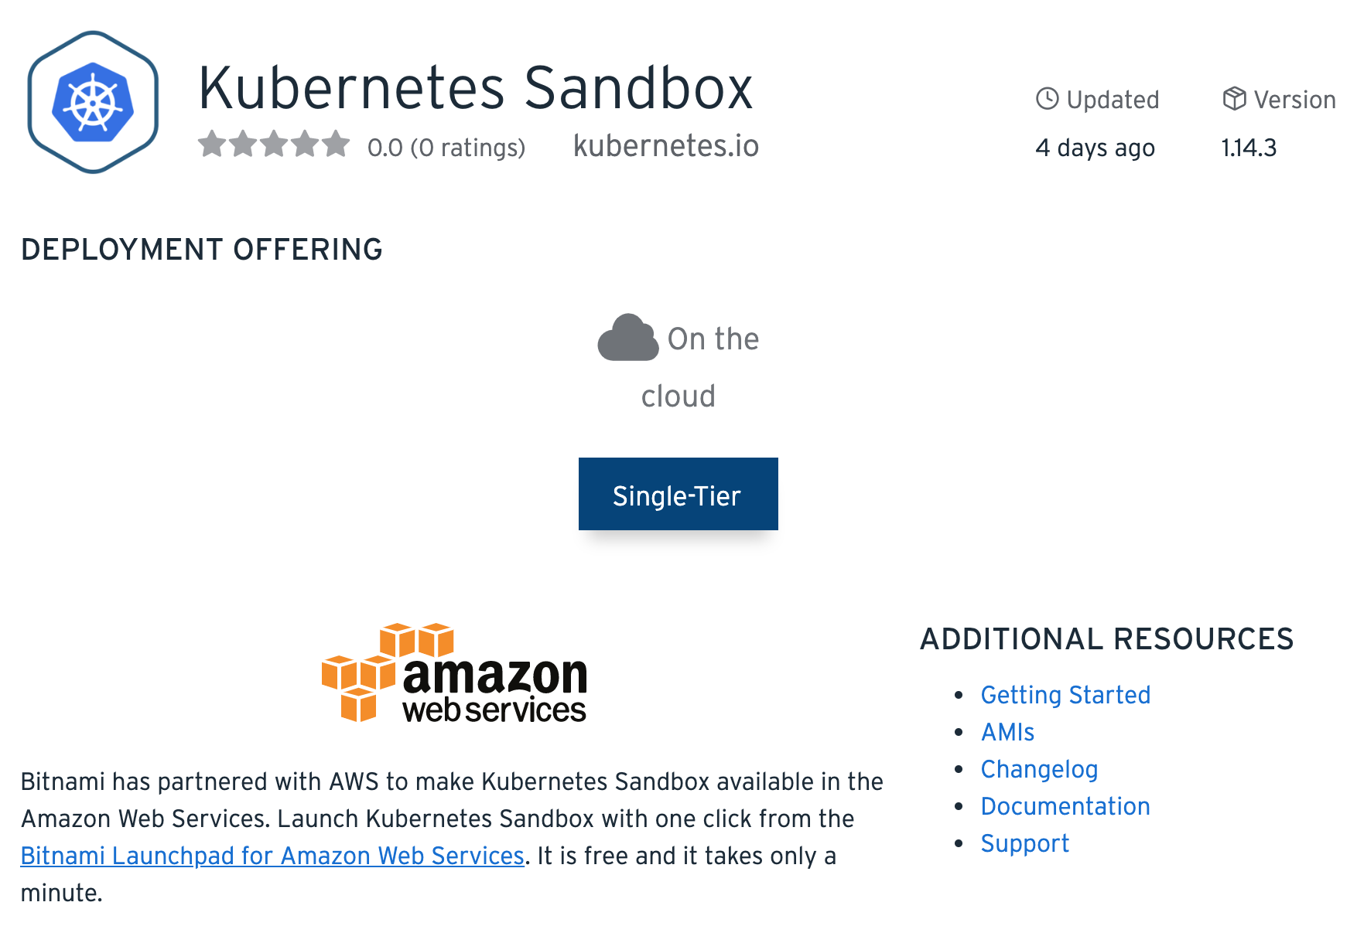
Bitnami Kubernetes Sandbox
Bitnami Kubernetes Sandbox
Preconfigured click-to-deploy K8s cluster. It provides a complete development environment for development applications.
It also includes:
Local Volume provisioner
Helm
Ingress Controller
Kubernetes Dashboard
Docs: https://docs.bitnami.com/aws/infrastructure/kubernetes-sandbox/
AMI: https://bitnami.com/stack/kubernetes-sandbox/cloud/aws

Slide 16
Minikube
Minikube
Install the latest release:
# Linux $ curl -Lo minikube https://storage.googleapis.com/minikube/releases/latest/minikube-linux-amd64 $ chmod +x minikube $ sudo mv minikube /usr/local/bin/ # OS X $ curl -Lo minikube https://storage.googleapis.com/minikube/releases/latest/minikube-darwin-amd64 $ chmod +x minikube $ sudo mv minikube /usr/local/bin/
What is Minikube?
Widely used testing Kubernetes distribution
All components are included in a single Golang executable, localkube
Minikube is open source and available on GitHub.
$ minikube start

Slide 17
Minikube
First steps
$ minikube status host: Running kubelet: Running apiserver: Running kubeconfig: Configured $ minikube ssh _ _ _ _ ( ) ( ) ___ ___ (_) ___ (_) | | /’) _ _ | |_ __ / ‘ _ ` _ `\ | | /’ _ `\ | | |, < ( ) ( ) | '_`\ /'__`\ | ( ) ( ) | | | | ( ) | | | | |\`\ | (_) | | |_) )( __/ (_) (_) (_) (_) (_) (_)(_)(_) (_)`\___/’ (_,_/'`\___)
$ exit $ minikube logs $ minikube help

Slide 18

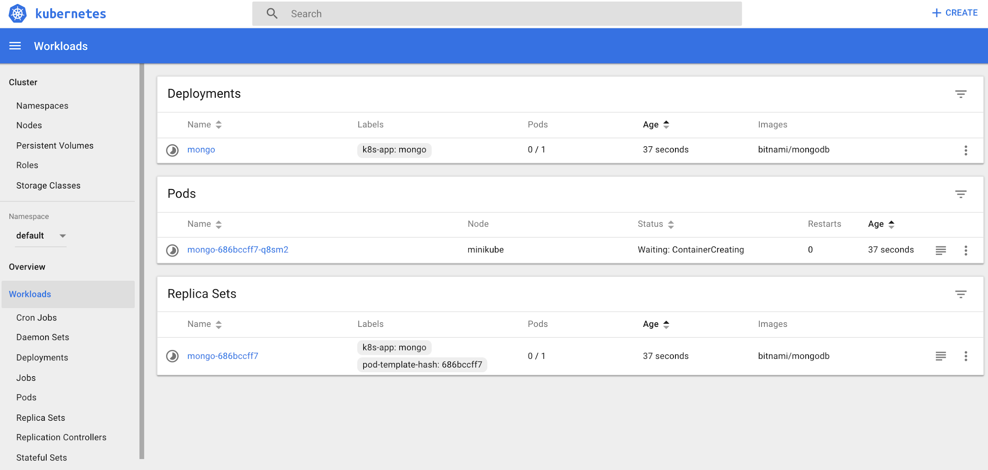
Starting Your First K8s Application via the Dashboard
Access the K8s Dashboard by running the command:
$ minikube dashboard 🔌 Enabling dashboard ... 🤔 Verifying dashboard health ... 🚀 Launching proxy ... 🤔 Verifying proxy health ... 🎉 Opening …
Click on +.
Click on Create from form.
Choose a name and specify bitnami/mongodb as a container image. Then click Deploy
What is happening?
Check the logs

Slide 19
Kubectl and the K8s API
kubectl
Introduction to Key Primitives
The Kubernetes API

Slide 20
Using the K8s CLI
Kubectl
Install Kubectl
# Linux $ curl -LO "https://storage.googleapis.com/kubernetes-release/release/$(curl -s https://storage.googleapis.com/kubernetes-release/release/stable.txt)/bin/linux/amd64/kubectl" # OS X $ curl -LO "https://storage.googleapis.com/kubernetes-release/release/$(curl -s https://storage.googleapis.com/kubernetes-release/release/stable.txt)/bin/darwin/amd64/kubectl" $ chmod +x ./kubectl $ sudo mv ./kubectl /usr/local/bin/kubectl
The Dashboard is nice to use but the Kubernetes CLI is extremely powerful.
The K8s CLI is called kubectl

Slide 21
Using the K8s CLI
Kubectl
Configure kubectl to use Minikube
# Get contexts $ kubectl config get-contexts CURRENT NAME CLUSTER AUTHINFO NAMESPACE * gke_XXXX gke_XXXX gke_XXXX minikube minikube minikube # Use minikube context $ kubectl config use-context minikube $ kubectl config current-context minikube
Docs: Kubectl Context and Configuration

Slide 22
Using the K8s CLI
Kubectl
You can use kubectl to discover the available k8s...
$ kubectl get pods $ kubectl get rs $ kubectl get ns
Learn more about the K8s API on the API Reference Documentation
Or browse around the K8s API…
$ kubectl proxy --port=8080 & $ curl http://127.0.0.1:8080/api { "kind": "APIVersions", "versions": [ "v1" ... $ curl http://127.0.0.1:8080/api/v1 { "kind": "APIResourceList", "groupVersion": "v1", "resources": [ ...

Slide 23
Deploying your Apps on K8s

Slide 24




Application Deployment
A common scenario: web application (frontend) using a database (backend)
Set of VMs running our web app
External Load Balancer
Frontend
Backend
Set of databases
Internal Load Balancer

Slide 25
Application Deployment
A common scenario: web application (frontend) using a database (backend)
However, this is not enough, we want:
Zero downtime
Failover mechanisms
Dynamic scalability
Rolling updates
Automatic deployments
Load Balancing
Easy migration
Monitoring
Role-Based Access Control
Continuous Integration and Delivery
Frontend
Backend

Slide 26






Application Deployment
A common scenario: web application (frontend) using a database (backend)
Zero downtime
Failover mechanisms
Dynamic scalability
Deployment
Configuration Resources
ReplicaSet
Load Balancing
Rolling updates
Automatic deployments
Frontend
SVC
Pods
Easy migration
Monitoring
Role-Based Access Control
Continuous Integration and Delivery
Nginx
Ingress
Deployment
Configuration Resources
ReplicaSet
Backend
SVC
Containers

Slide 27


Pets vs Cattle
A different approach for your servers
Pets:
Treated as unique
Typically manually built, managed and updated.
Indispensable, can’t be down
Cattle:
Treated as “just one more”
Automatically built
Designed for failure
Interesting read: The History of Pets vs Cattle and How to Use the Analogy Properly

Slide 28
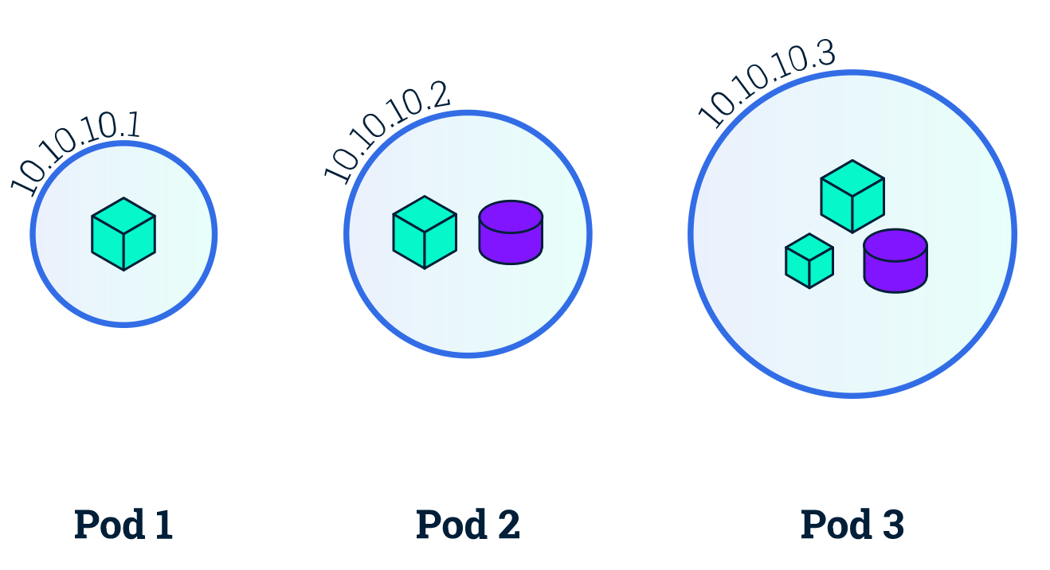
Basic Objects: Pod
Smallest compute unit in Kubernetes. Top level API object to run containers.
Represents a group of colocated containers sharing storage resources and a unique IP.
Pods are EPHEMERAL
Container
Volume

Slide 29
Why pods?
K8s is supposed to manage containers, but pods are the basic building block...
“one process, one container” principle.
No more VMs with dozens of applications. Use a container per process.
But… I need more than one app/process cooperating to run my service
It seems it makes sense to run more than one container sharing storage resources, IP and port space to ensure efficient communication between them.
There are some other reasons why it’s necessary to use pods:
A container can be a Docker container.. But also Rocket or a VM managed by Virtlet. Each solution has different requirements/specifications.
K8s needs additional information:
Restart policies
Readiness/Liveness probes
It makes sense to add a new layer of abstraction to define all this information which exceed container duties.

Slide 30
Activity: multi-container or multiple pods
NGINX and PHP-FPM
WP and MariaDB database
MongoDB master and slaves

Slide 31
Describing K8s objects
Describing K8s objects
Yaml Skeleton
apiVersion: v1 # required field kind: Pod # required field metadata: # required field name: mongo # required field namespace: default labels: app: mongo ... spec: # required field containers: - image: myImage:latest ... status: hostIP: X.X.X.X phase: Running ...
Reference: Understanding Kubernetes Objects
metadata:
Data that helps uniquely identify the object
spec:
Different on every K8s object.
Describes the characteristics of the K8s object

Slide 32
Pods
Pods
apiVersion: v1 kind: Pod metadata: name: mongo spec: containers: - image: bitnami/mongodb name: mongo
For specifications well documented. See also the user-guide.
$ kubectl create -f mongo.yaml $ kubectl get pods NAME READY STATUS RESTARTS AGE mongo 1/1 Running 0 15s
Create your first pod:

Slide 33
Labels
apiVersion: v1 kind: Pod metadata: ... labels: pod-template-hash: "3378155678" run: mongo
Labels
You can define your labels in the object specifications.
Labels are key/value pairs that are attached to objects, such as pods.
You can also add labels on the fly:
$ kubectl label pods mongo foo=bar $ kubectl get pods --show-labels NAME READY STATUS RESTARTS AGE LABELS mongo 1/1 Running 0 11m foo=bar
Why use labels ?
Because they are a great way to query and select resources. E.g., if you want to force the scheduling of a Pod on a specific node you can use a nodeSelector in a Pod definition. Add specific labels to certain nodes in your cluster and use that labels in the Pod.
You can then query by label and display labels in new columns:
$ kubectl get pods -l foo=bar NAME READY STATUS RESTARTS AGE mongo 1/1 Running 0 10m $ kubectl get pods -L foo NAME READY STATUS RESTARTS AGE FOO mongo 1/1 Running 0 5m bar

Slide 34

Basic Objects: ReplicaSet
Zero downtime
Failover mechanisms
Dynamic scalability
A replica set ensures that a specified number of pod “replicas” are running at any one time.
In other words, a replication controller makes sure that a pod or homogeneous set of pods are always up and available.
ReplicaSet
ReplicaSet
ReplicaSet

Slide 35
Replicaset
Replicaset
apiVersion: apps/v1 kind: ReplicaSet metadata: name: nginx namespace: default spec: replicas: 2 selector: matchLabels: app: nginx template: metadata: labels: app: nginx spec: containers: - image: bitnami/nginx name: nginx
Create a replicaset:
$ kubectl create -f rs.yaml
For specifications well documented.
Try to scale it and watch:
$ kubectl scale rs nginx --replicas=5 replicaset "nginx" scaled $ kubectl get pods --watch

Slide 36
Basic Objects: Deployment
Rolling updates
Automatic deployments
Deployment is a higher-level concept that manages ReplicaSets. It allows several management operations like:
Replica management
Pod scaling
Rolling updates
Rollback to a previous version
Clean-up policies
Deployment
ReplicaSet

Slide 37
Deployment
Deployment
apiVersion: apps/v1 kind: Deployment metadata: name: nginx namespace: default spec: replicas: 2 revisionHistoryLimit: 2 strategy: type: RollingUpdate selector: matchLabels: app: nginx template: metadata: labels: app: nginx spec: containers: - image: bitnami/nginx name: nginx ports: - name: http containerPort: 8080
For specifications well documented.
Create a deployment:
$ kubectl create -f deployment.yaml

Slide 38
Scaling and Rolling Update of Deployments
Just like RS, Deployments can be scaled:
$ kubectl scale deployment nginx --replicas=4 deployment "nginx" scaled $ kubectl get deployments NAME DESIRED CURRENT UP-TO-DATE AVAILABLE AGE nginx 4 4 4 1 12m
What if you want to update all your Pods to a specific image version?
$ kubectl set image deployment nginx nginx=bitnami/nginx:1.16.0-r60 --all
Watch the RS and the Pods:
$ kubectl get rs --watch NAME DESIRED CURRENT AGE nginx-2529595191 0 0 3m nginx-3771699605 4 4 46s
You can also use:
$ kubectl edit deployment nginx

Slide 39
Deployments Rollback
When you create a deployment you can record your changes in annotations:
$ kubectl run dokuwiki --image=bitnami/dokuwiki --record $ kubectl get deployments dokuwiki -o yaml
metadata: annotations: deployment.kubernetes.io/revision: "1" kubernetes.io/change-cause: kubectl run dokuwiki --image=bitnami/dokuwiki --record=true

Slide 40
Deployments Rollback
Now do an update and check the status. You will see that the Pod failed. You can now roll back.
$ kubectl set image deployment/dokuwiki dokuwiki=bitnami/dokuwiki:09 --all $ kubectl rollout history deployment/dokuwiki deployments "dokuwiki": REVISION CHANGE-CAUSE 1 kubectl run dokuwiki --image=bitnami/dokuwiki:09 --record=true 2 kubectl set image deployment/dokuwiki dokuwiki=bitnami/dokuwiki:09:09 --all=true $ kubectl get pods NAME READY STATUS RESTARTS AGE dokuwiki-2141819201-tcths 0/1 ImagePullBackOff 0 1m $ kubectl rollout undo deployment/dokuwiki $ kubectl get pods NAME READY STATUS RESTARTS AGE dokuwiki-3378155678-eq5i6 1/1 Running 0 7s

Slide 41
Kubectl Tips and Tricks
$ kubectl config view $ kubectl config use-context $ kubectl annotate $ kubectl label $ kubectl create -f ./<DIR> $ kubectl create -f <URL> $ kubectl edit ... $ kubectl proxy ... $ kubectl exec ... $ kubectl logs ... $ kubectl get pods, svc, deployments $ kubectl --v=99 ... $ kubectl describe ...
A few things to remember about kubectl. And if you don't, check the cheat sheet.

Slide 42
Hands on!
Guestbook – Part I
Create frontend deployment
Access the frontend using kubectl port forward. What do you see?
Create backend deployment. What now?

Slide 43
Services
Services to expose your application

Slide 44
Basic Objects: Services
Now that we have a good handle on creating resources, managing and inspecting them with kubectl. The elephant in the room is how do you access your applications?
The answer is Services, another Kubernetes object.
Services are abstractions that define a set of pods that provide a micro-service
Frontend
SVC
They provide a stable virtual endpoint for ephemeral Pods in your cluster. Other services can target them and will be redirected to the endpoints that match the service Pod selection
Backend
SVC
In addition you can use the Service abstraction to expose external resources into your K8s clusters

Slide 45
Services
Implemented via iptables.
kube-proxy agent running on all Kubernetes nodes, watches Kubernetes API for new Services and Endpoints being created.
It opens random ports on nodes to listen to traffic to the ClusterIP:Port, and redirects to a random service endpoints (used to be round-robin in userspace implementation).
Backend Pod 1
Labels: app-MyApp
Port: 9376
Backend Pod 2
Labels: app-MyApp
Port: 9376
Backend Pod 3
Labels: app-MyApp
Port: 9376
apiserver
1) Watch Services and Endpoints
5) Proxy to a backend
kube-proxy
4) Redirect to (random) proxy port
2) Open proxy port and set portal rules
iptables
3) Connect to 10.0.0.1:1234
Client

Slide 46
Services Types
ClusterIP
NodePort
LoadBalancer
ClusterIP service type is the default and only provides access internally (except if manually creating an external endpoint).
You can run a kubectl proxy locally to access a ClusterIP service. Great for development.
NodePort type is great for debugging, but you need to open your firewall on that port (NodePort range defined in Cluster configuration). Also used when you want to create your load balancer manually.
LoadBalancer services are currently only implemented on public cloud providers like GKE, AKS or AWS.
Private cloud solutions also may implement this service type if there is a Cloud provider plugin for them in K8s.

Slide 47



Basic Objects: Services
Types:
172.100.3.3:8080
172.100.3.4:8080
172.100.3.5:3306
ClusterIP
NodePort
LoadBalancer
mysql
wordpress
192.168.3.4:3306
192.168.3.3:80
K8s cluster
External
wordpress
wordpress
wordpress
wordpress
40.0.2.4:33311
40.0.2.5:33311
40.0.2.6:33311
40.0.2.7:33311
wordpress
30.3.2.6:80

Slide 48
Services
Services
apiVersion: v1 kind: Service metadata: name: nginx namespace: default spec: type: ClusterIP ports: - name: http port: 80 targetPort: http selector: app: nginx
For specifications well documented.
You can also expose a deployment on the fly. Let's try it:
$ kubectl expose deployment/nginx --name nginx --port=80 --target-port=8080 --type=NodePort $ kubectl get svc NAME TYPE CLUSTER-IP EXTERNAL-IP PORT(S) AGE nginx NodePort 10.100.56.229 <none> 80:30306/TCP 8s

Slide 49
DNS
DNS
$ kubectl create -f busybox.yaml $ kubectl exec -it busybox -- nslookup nginx Server: 10.96.0.10 Address 1: 10.96.0.10 kube-dns.kube-system.svc.cluster.local Name: nginx Address 1: 10.111.180.87 nginx.default.svc.cluster.local $ kubectl get svc NAME TYPE CLUSTER-IP EXTERNAL-IP PORT(S) AGE kubernetes ClusterIP 10.96.0.1 <none> 443/TCP 43m nginx NodePort 10.1.1.87 <none> 80:31436/TCP 40m $ kubectl exec -ti busybox -- wget http://nginx Connecting to nginx (10.0.0.112:80) index.html 100% |*******************************| 612 0:00:00 ETA $ kubectl exec -ti busybox -- cat index.html
A DNS service is provided as a Kubernetes add-on in clusters. On GKE, Minikube and K8s Sandbox this DNS service is provided by default.
A service gets registered in DNS and DNS lookup will further direct traffic to one of the matching Pods via the ClusterIP of the service.
Interesting read.

Slide 50
Hands on!
Guestbook – Part II
Add services to the backend. What changed?
Add a service for the frontend

Slide 51
Configuring your Apps on K8s

Slide 52
Configuring your apps via env. vars
environment variables
Take a look to the different configurations supported on the Bitnami MySQL Docker Image...
As you can check, we can use the env. variable ALLOW_EMPTY_PASSWORD to configure MySQL to disable authentication. Use it on a Pod:
Using environment variables is one of the most extended methods to configure containerized apps.
apiVersion: v1 kind: Pod metadata: name: mysql spec: containers: - name: mysql image: bitnami/mysql env: - name: ALLOW_EMPTY_PASSWORD value: "yes"
No password is needed as you can check:
$ kubectl create -f mysql.yaml
$ kubectl exec –it mysql -- mysql -h 127.0.0.1

Slide 53
Using secrets
Secrets
You can create, get, delete secrets.
$ kubectl get secrets $ kubectl create secret generic --help $ kubectl create secret generic mysql --from-literal=password=root
In order to pass sensitive information to the applications we deploy, we used secrets.
Common sensitive data:
passwords, ssh keys, Oauth tokens, etc.
You can use them in a Pod:
apiVersion: v1 kind: Pod metadata: name: mysql spec: containers: - name: mysql image: bitnami/mysql env: - name: MYSQL_ROOT_PASSWORD valueFrom: secretKeyRef: name: mysql key: password
Is it secure?
NOT ENCRYPTED
$ kubectl get secret mysql -o json | jq -r '.data.password' | base64 --decode
Solution for GitOps: Sealed Secrets

Slide 54
Namespaces
Namespaces
Common commands:
$ kubectl get ns $ kubectl create ns myns $ kubectl get ns/myns -o yaml $ kubectl delete ns/myns
Namespaces are intended to isolate multiple groups/teams and give them access to a set of resources.
Each namespace can have quota
You can define RBAC policies in namespaces
Create a POD in myns:
$ cat << 'EOF' >> mongo-ns.yaml > apiVersion: v1 > kind: Pod > metadata: > name: mongo > namespace: myns > spec: > containers: > - image: bitnami/mongodb > name: mongo
> EOF
$ kubectl create -f mongo-ns.yaml

Slide 55
Use Case: Canary Deployments
Labels, Services and Deployments are key to Canary deployments scenarios.
Typical Steps:
Create two deployments
Add labels that differentiate the canary plus a common label
Create a service that selects all Pods from the two deployments
selector: app: guestbook <CHOOSE YOUR LABEL>

Slide 56
Exercises

Slide 57
Exercises
Basic CLI Exercises
Exercise 1: Find the equivalent kubectl command to:
Exercise 2: Find the way to copy files to containers in a pod
Exercise 3: Find the way to, given a yaml file, show the difference to what is currently deployed
Exercise 4: Find the way to set the environment variable “MODE=production” in all of the running pods
Exercise 5: Find the way to obtain the list of recent events that occurred in the cluster
$ docker run --rm --name mytest -ti bitnami/minideb bash

Slide 58
More exercises
Minikube:
Exercise 6: Enable the plugin freshpod. Find what it is for and try its features
Kubernetes API Objects
Exercise 7: Find information about the API Object ConfigMap. What is the difference compared to Secrets? Use it in an example
Exercise 8: Find information about the API Objects LimitRanges and ResourceQuotas. Use them in an example
Kubernetes API Objects
Exercise 9: Try creating, modifying and deleting using curl instead of kubectl

Slide 59
Deliverables
Deliverable 1: WordPress + MariaDB with Canary
Create a namespace
Use deployments to create WP+MariaDB
You will need to set some env. variables
Use configMap to configure the apps
Use secrets for sensitive data
Add Liveness & Readiness Probes on your containers.
Create the corresponding services to access WordPress
Canary Deployment
Consider WP 5.3.1 the stable version
Use WP 5.3.2 for the canary
Useful link: Available env. variables on WP Image

Slide 60
Deliverables
Deliverable 2: WordPress + MariaDB with replication
Create a namespace
Use deployments to create WP+MariaDB (with replication enabled)
You will need to set some env. variables
Use configMap to configure the apps
Use secrets for sensitive data
Add Liveness & Readiness Probes on your containers.
Manage the resources on your containers.
Create the corresponding services to access WordPress
Use HyperDB WP plugins to balance SQL requests. Useful link:
https://wordpress.org/plugins/hyperdb

Slide 61
Thank You

